Slide 1

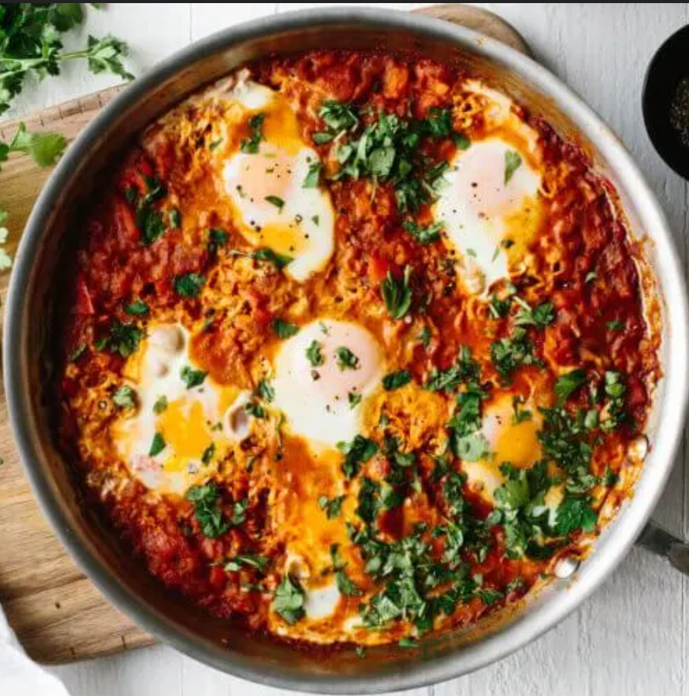
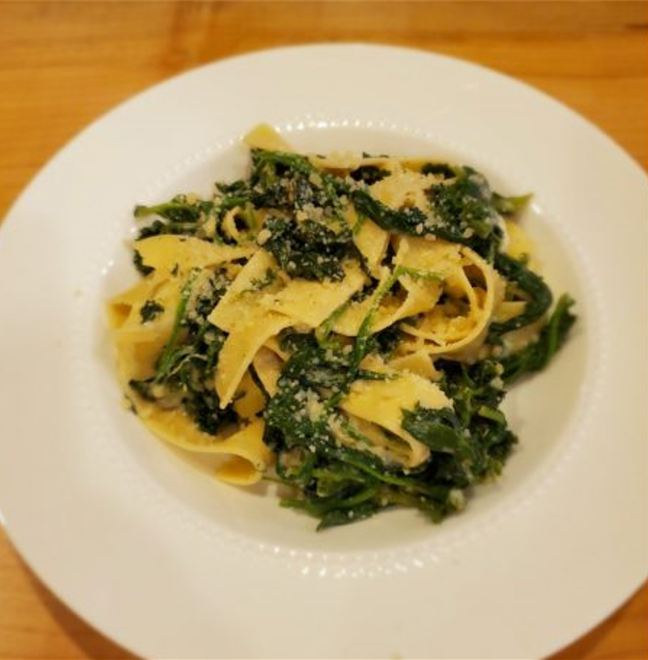
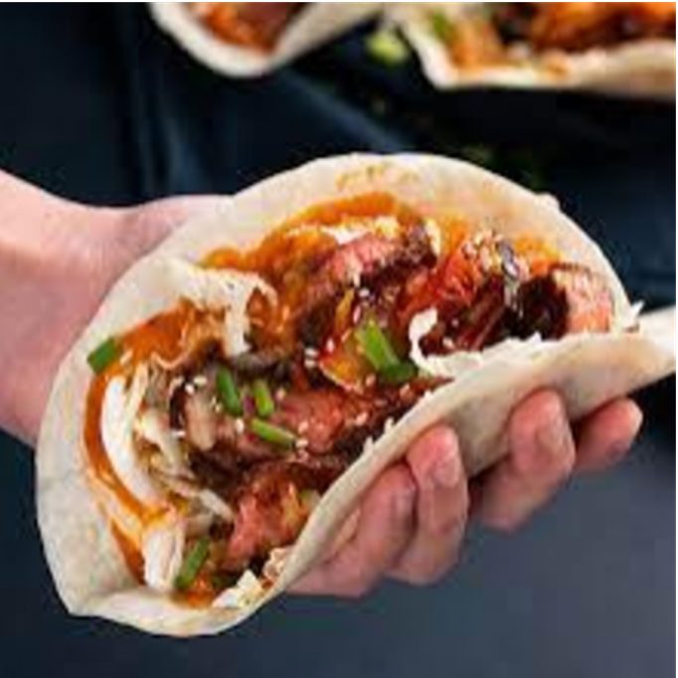
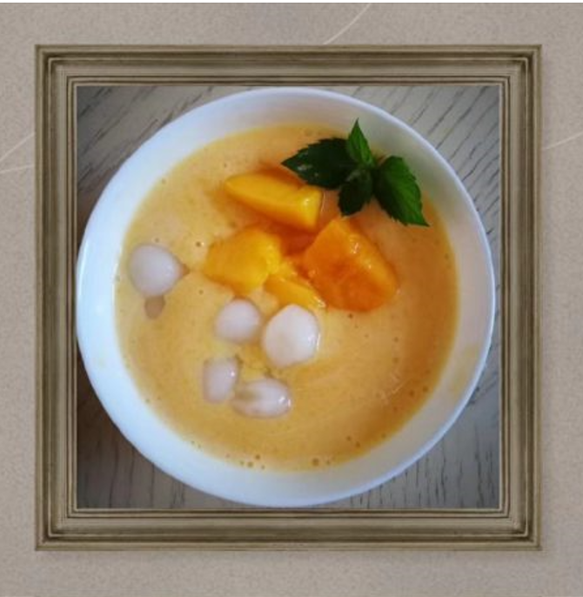
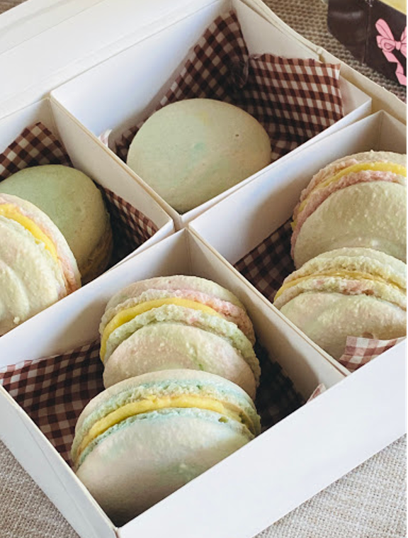
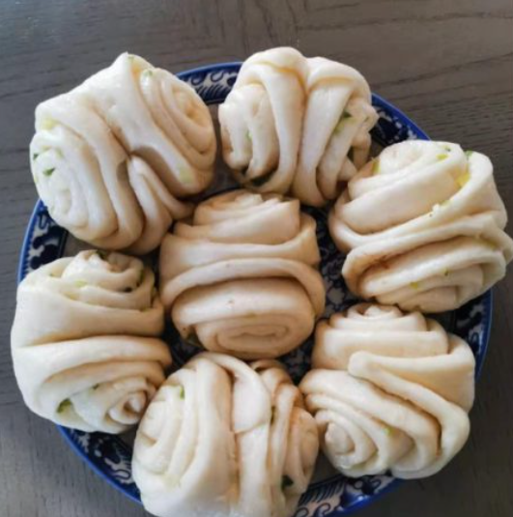
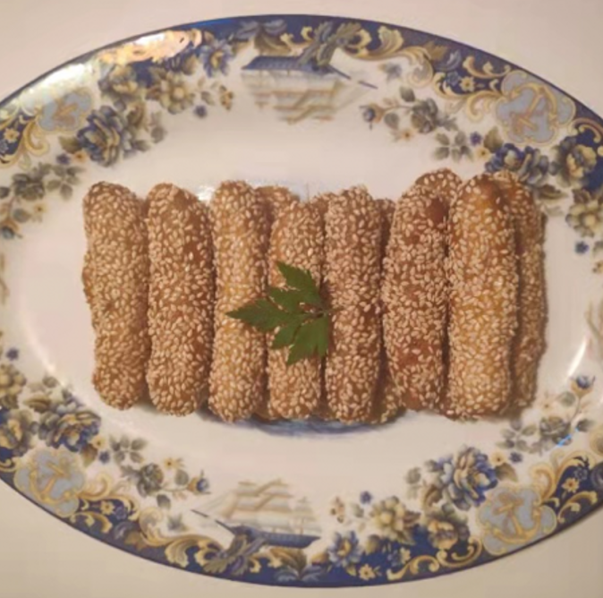
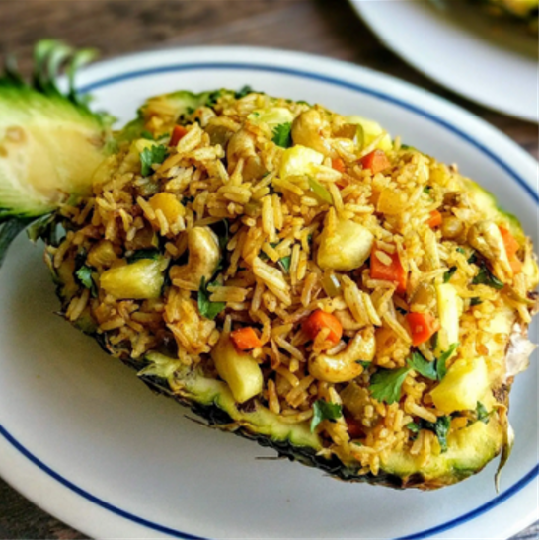


Tyee Cooking Club:
Student Samples from 2020-2021:

Slide 2

Tyee Cooking Club:
Club Leaders:
Sonya Elder – Nutrition PHD
Joann Oshima – Certified Nutrition Coach
Lily Yin – Club Coordinator
Student Chairs:
Lucy Sang, Crystal Han, Christine Qiu, Aiden Yin and Linda Yan

Slide 3
Tyee Cooking Club:
Most Sunday afternoon (Starting time - 80% at 4:30pm and 20% at 7:00pm)
First club session is on 10/16/2022
All sessions will be held on Zoom.
Session duration: 1 – 1.5 hours

Slide 4
Tyee Cooking Club:
Club Calendar:
10/16, 10/23, 10/30, 11/6, 11/13, 11/20, 11/27, 12/4, 12/11, 1/8, 1/15, 1/22, 1/29, 2/5, 2/12, 3/5, 3/12, 3/19, 3/26, 4/2 , 4/23 and 4/30
Year end party TBD
Designed Topic Samples:
Plate Methods, Basic Nutrition, Snacks, Beverages, Sugar, Kitchen Tools, Food Nutrition etc.

Slide 5
Tyee Cooking Club:
Registration Link will be published on Tyee Times at October 8th 9:30am
(https://tyeeptsa.org/Page/PTSA/Newsletters)
Registration Fee: $20 per student
Per Tyee PTSA, registration and payment are separate pages on the PTSA website. Please finish both registration and payment steps. Registration is not complete until paid in full.
Please arrange 20-40mins to finish the preparation steps before the cooking session starts.

Slide 6
Tyee Cooking Club:
If you have any questions, please contact Lily Yin at cookingclub@tyeeptsa.org

